Slide 1

Locking and Concurrency
Davut Kurt
Summer Intern - 2019

Slide 2
Overview
One of the key challenges in developing multi‐user, database‐driven applications is to maximize concurrent access but, at the same time, to ensure that each user is able to read and modify the data in a consistent fashion.
The locking and concurrency controls that allow this to happen are key features of any database, and Oracle excels in providing them.

Slide 3
What are Locks?
A lock is a mechanism used to regulate concurrent access to a shared resource.
For example, while a stored procedure is executing, the procedure itself is locked in a mode that allows others to execute it, but will not permit another user to alter it in any way.
Locks are used in the database to permit concurrent access to these shared resources, while at the same time providing data integrity and consistency.

Slide 4
Locking Issues
Before we discuss the various types of locks that Oracle uses, it is useful to look at some locking issues ‐ many of which arise from badly designed applications that do not make correct use (or make no use) of the Databaseʹs locking mechanisms.

Slide 5
Lost Updates
A lost update occurs when two different transactions are trying to update the same column on the same row within a database at the same time. Typically, one transaction updates a particular column in a particular row, while another that began very shortly afterward did not see this update before updating the same value itself. The result of the first transaction is then “lost”, as it is simply overwritten by the second transaction.

Slide 6
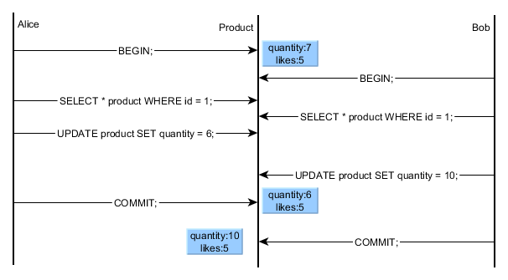
1. User 1 retrieves (queries) a row of data.
2. User 2 retrieves that same row.
3. User 1 modifies that row, updates the database and commits.
4. User 2 modifies that row, updates the database and commits.

Slide 7
Pesimistic Locking
A pessimistic locking strategy assumes that the probability is high that another user will try to modify the same row in a table that you are changing. A lock is held between the time a row is selected and the time that a searched update or delete operation is attempted on that row (for example, by using the repeatable read isolation level or lock the table in exclusive mode).

Slide 8
The advantage of pessimistic locking is that it is guaranteed that changes are made consistently and safely. The major disadvantage is that this locking strategy might not be very scalable. On a system with many users or with long-living transactions, or when transactions involve a greater number of entities, the probability of having to wait for a lock to be released increases.

Slide 9
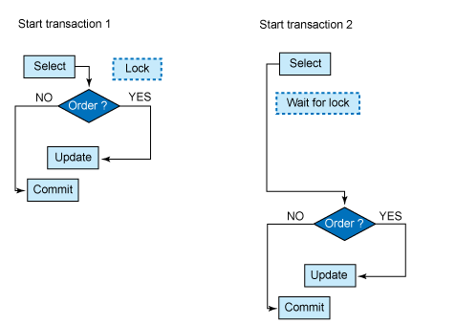
Transaction 1 reads a specific record and places a lock on that row. It takes some time to decide whether the row will be updated.
In the meantime, transaction 2 wants access to that same row, but it has to wait until the lock is released by Transaction 1.
Until then, transaction 2 will receive results from its SELECT and can continue with its business logic.

Slide 10
Optimistic Locking
The main problem with a pessimistic locking approach is that transactions have to wait for each other. A way to avoid this is to follow an optimistic locking strategy and assume that it is very unlikely that another user will try to change the same row that you are changing. If the row does change, the update or delete will fail, and the application logic handles such failures by, for example, retrying the select.
With this approach, no locks are held between selecting and updating, or deleting a row. But, consequently, this method requires a way to ensure that the data has not changed between the time of being read and being altered.

Slide 11
Although more retry logic in the application is needed, the primary advantage of an optimistic locking strategy is that it minimizes the time for which a given resource is unavailable for use by other transactions and thus will be a more scalable locking alternative than pessimistic locking.

Slide 12
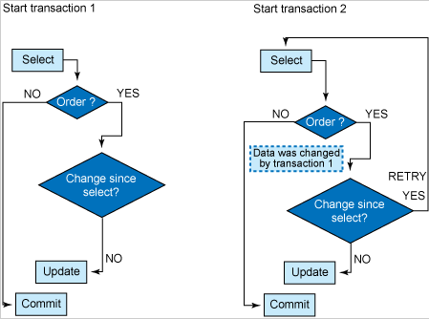
Transaction 1 reads a specific record but then releases its lock. Transaction 2 is now not prevented from retrieving that same row.
Before committing the transaction, both transaction 1 and transaction 2 must check whether the row has changed after the previous SELECT.
If a change has occurred, the transaction must restart with a new SELECT in order to retrieve the current data.
However, if that row has not been changed after the previous SELECT, the data can be successfully updated.

Slide 13
Blocking
Blocking occurs when one session holds a lock on a resource that another session is requesting.
As a result, the requesting session will be blocked, it will ʹhangʹ until the holding session gives up the locked resource. In almost every case, blocking is avoidable.
In fact, if you do find yourself blocking in an interactive application you are most likely suffering from the lost update bug described above (your logic is flawed and that is the cause of the blocking).

Slide 14
There are four common DML statements that will block in the database ‐ INSERT, UPDATE, DELETE, and SELECT FOR UPDATE.
The solution to a blocked SELECT FOR UPDATE is trivial: simply add the NOWAIT clause and it will no longer block.
Instead, your application would report back to the end user that the row is already locked.
The interesting cases are the remaining three DML statements. We will look at each of them and see why they should not block, and when they do ‐ how to correct that.

Slide 15
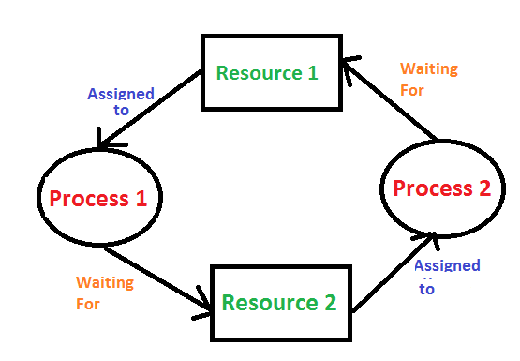
Deadlocks
Deadlock occurs when two or more processes want to access mutually locked resources. System resources are adversely affected because both processes are constantly waiting for each other.

Slide 16
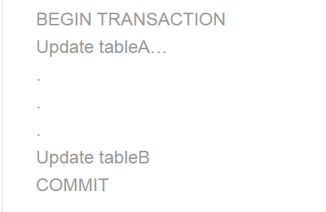
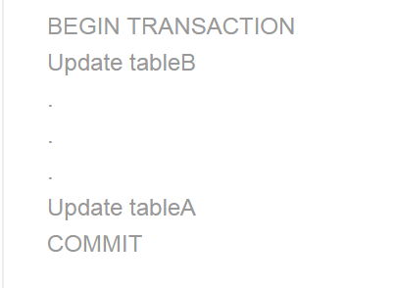
Session 1
Session 2

Slide 17
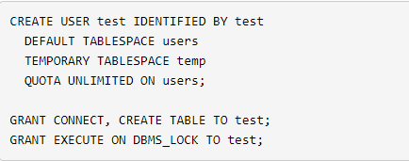
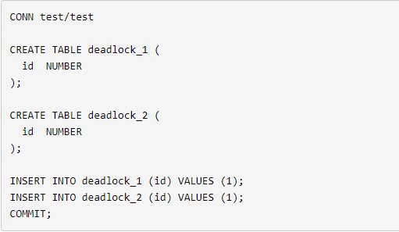
Oracle automatically detects and resolves deadlocks by rolling back the statement associated with the transaction that detects the deadlock. Typically, deadlocks are caused by poorly implemented locking in application code. This article shows the steps necessary to identify the offending application code when a deadlock is detected.
Create a test user : Create a test schema :

Slide 18
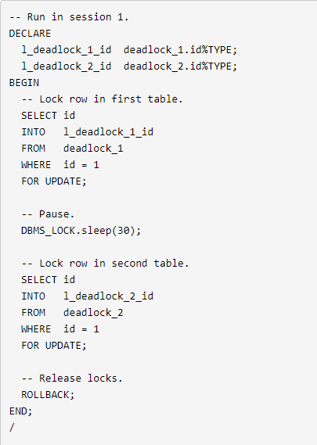
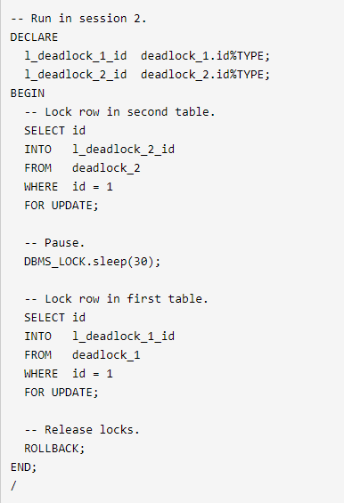
Start two SQL*Plus sessions, each logged into the test user, then run the following pieces of code, one in each session.

Slide 19
The first piece of code gets a lock on a row in the DEADLOCK_1 table, it pauses for 30 seconds, then attempts to get a lock on a row in the DEADLOCK_2 table. The second piece of code does the same thing but in reverse, locking a row in the DEADLOCK_2 table, then the DEADLOCK_1 table. The call to the DBMS_LOCK.SLEEP procedure is only present to give you enough time to switch sessions.

Slide 20

Eventually, one of the sessions will detect the deadlock, rollback its transaction and produce a deadlock error, while the other transaction completes successfully. A typical deadlock error is displayed below.
In addition to the deadlock error reported to the session, a message is placed in the alert log.

Slide 21
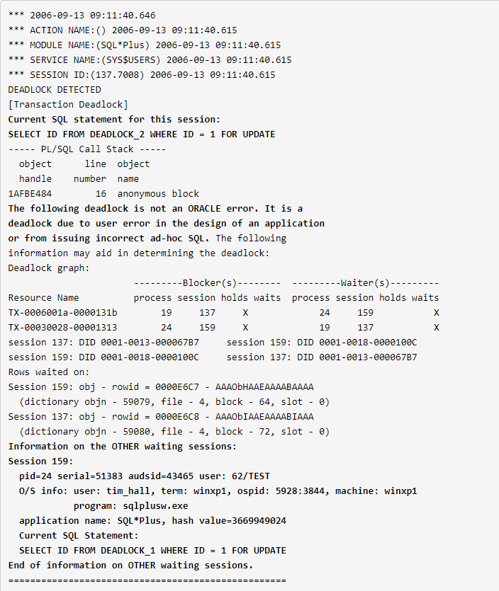
The error message contains a reference to a trace file, whose contents indicate the SQL statements blocked in both the session that detected the deadlock and the other blocked sessions.

Slide 22
Unlike in many other RDBMSs, deadlocks are so rare in Oracle they can be considered almost non‐existent.
Typically, you must come up with artificial conditions to get one.
The number one cause of deadlocks in the Oracle database, is un‐indexed foreign keys. There are two cases where Oracle will place a full table lock on a child table after modification of the parent table.
If you update the parent tableʹs primary key (a very rare occurrence if you follow the rules of relational databases that primary keys should be immutable), the child table will be locked in the absence of an index.
If you delete a parent table row, the entire child table will be locked (in the absence of an index) as well.

Slide 23
Lock Escalation
DB locks can exist on rows, pages or whole tables or indexes. When a transaction is in progress, the locks held by the transaction take up resources.
Lock escalation is where the system consolidates multiple locks into a higher level one (for example consolidating multiple row locks to a page or multiple pages to a whole table) typically to recover resources taken up by large numbers of fine-grained locks.

Slide 24
Types of Lock
The five general classes of locks in Oracle are listed below. The first three are common (used in every Oracle database) and the last two are unique to OPS (Oracle Parallel Server). We will introduce the OPS‐specific locks, but will concentrate on the common locks:
DML locks
DDL locks
Internal locks and latches
Distributed locks
PCM (Parallel Cache Management) Locks

Slide 25
DML locks
DML locks are used to ensure only one person at a time modifies a row, and that no one can drop a table upon which you are working. Oracle will place these locks for you.

Slide 26
TX ‐ (Transaction) Locks
All DML locks oracle acquires automatically are row-level locks.
No limit to number of row locks held by a transactıon.
Oracle does not escalate locks from the row level.
Row locking provides the lowest level of locking possible provides the best possile transaction concurrency.
Readers of data do not wait for writers of the same data rows.

Slide 27
A modified row is always locked exclusively so other users cannot modify the row until the transactiın holding the lock is committed or rolled back.
If transaction obtains a row lock for a row, the transaction also acquries a table lock for the corresponding table. the table lock prevents conflicting DDL operations that would override data changes in a current transaction.
Note : A transaction gets exclusive DML lock for each row modified by any of the following statements :
Insert, Update, Delete and Select with the For Update clause.

Slide 28
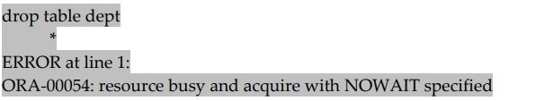
TM ‐ (DML Enqueue) Locks
These locks are used to ensure that the structure of a table is not altered while you are modifying its contents. For example, if you have updated a table, you will acquire a TM lock on that table. This will prevent another user from executing DROP or ALTER commands on that table. If they attempt to perform DDL on the table while you have a TM lock on it, they will receive the following error message :

Slide 29
DDL Locks
A data dictionary (DDL) lock protects the definition of a schema object while it is acted upon or referred to by an ongoing DDL operation.
For example, when a user creates a procedure, Oracle Database automatically acquires DDL locks for all schema objects referenced in the procedure definition.
The DDL locks prevent these objects from being altered or dropped before procedure compilation is complete.
There are three types of DDL locks.

Slide 30
Exclusive DDL locks
Exclusive locks are placed on resources whenever a write operation (INSERT, UPDATE And DELETE) are performed.
Only one exclusive lock can be placed on a resource at a time. i.e. the first user who acquires an exclusive lock will continue to have the sole ownership of the resource, and no other user can acquire an exclusive lock on that resource.

Slide 31
Share DDL locks
Shared locks are placed on resources whenever a read operation (select) is performed.
Multiple shared locks can be simultaneously set on a resource.

Slide 32
Breakable Parse locks
Breakable parse locks are library cache locks which are held briefly during the compilation time/parsing time of SQL or PL/SQL codes.
They are released at the end of the compilation/parsing.
They are known as breakable parse locks as they are not released, and only can be broken when the object is un-pinned.

Slide 33
What is Concurrency Control?
Concurrency Control are the collection of the functions that the database provides in order to allow many people to access and modify data simultaneously.
The lock mechanism affects concurrency.
Oracle's multi-versioning model for read consistency is always applied at the statement level and can also be applied the transaction level.

Slide 34
Transaction Isolatıon Levels
The SQL92 standard defines four levels of transaction isolation, with different possible outcomes for the same transaction scenario.
These isolation levels are defined in terms of three ‘phenomena’ that are either permitted or not a given isolation level :
Dirty Read
Non-Repeatable Read
Phantom Read

Slide 35
Isolation Levels
Repeatable Read : Data that has been updated but has not yet been initialized cannot be read or updated by other transactions until it has been committed.
Read Committed : Data that is being updated by other transactions cannot be read until the update process is complete.
Read Uncommitted : Data that is being updated by other transactions but that has not yet been updated can be read.

Slide 36
Serializable
This is generally considered the most restrictive level of transaction isolation, but provides the highest degree of isolation.
Serializable transactions see only those changes that were committed at the time the transaction began, plus those changes made by the transaction itself through INSERT, UPDATE, and DELETE, statements. Serializable transactions do not experience nonrepeatable reads or phantoms.

Slide 37

References
https://docs.oracle.com/cd/E11882_01/server.112/e41084/ap_locks001.htm#SQLRF55502
https://docs.oracle.com/database/121/SQLRF/ap_locks002.htm#SQLRF55509
https://oracle-base.com/articles/misc/deadlocks
https://docs.oracle.com/cd/E11882_01/server.112/e40540/consist.htm#CNCPT1320
http://www.dba-oracle.com/

Slide 38
Thank you for listening.

